Slide 1

Landlab –Terrainbento
GSA Short Course
October 2020
Benjamin Campforts
@CSDMS
@BenjaminCa
Notes:
Did you ever code in any programming language?
Did you ever code in python?
Have you ever run a Landscape Evolution Model?
Have you ever used the Landlab open-source Python-language package
Have you ever made your own LEM? It seems that LEMs are pretty useful tools.
Why would you use LEMs? Because they:
provide insight into the geomorphic history
create testable predictions of landform development
demonstrate the consequences of current geomorphic process theory
spark imagination through hypothetical scenarios
What do you consider most challenging in applying it to your research question?

Slide 2
Why would you use LEMs? Because they:
provide insight into the geomorphic history
create testable predictions of landform development
demonstrate the consequences of current geomorphic process theory
spark imagination through hypothetical scenarios

Slide 3
Terrainbento: multi-model analysis in Earth surface dynamics
Why LEMs
provide insight into the geomorphic history
create testable predictions of landform development
demonstrate the consequences of current geomorphic process theory
spark imagination through hypothetical scenarios

Slide 4
Why Terrainbento
4 last decades
many alternative formulations for the redistribution of mass by Earth surface processes,
relatively few studies have systematically compared and tested these alternative equations

Slide 5
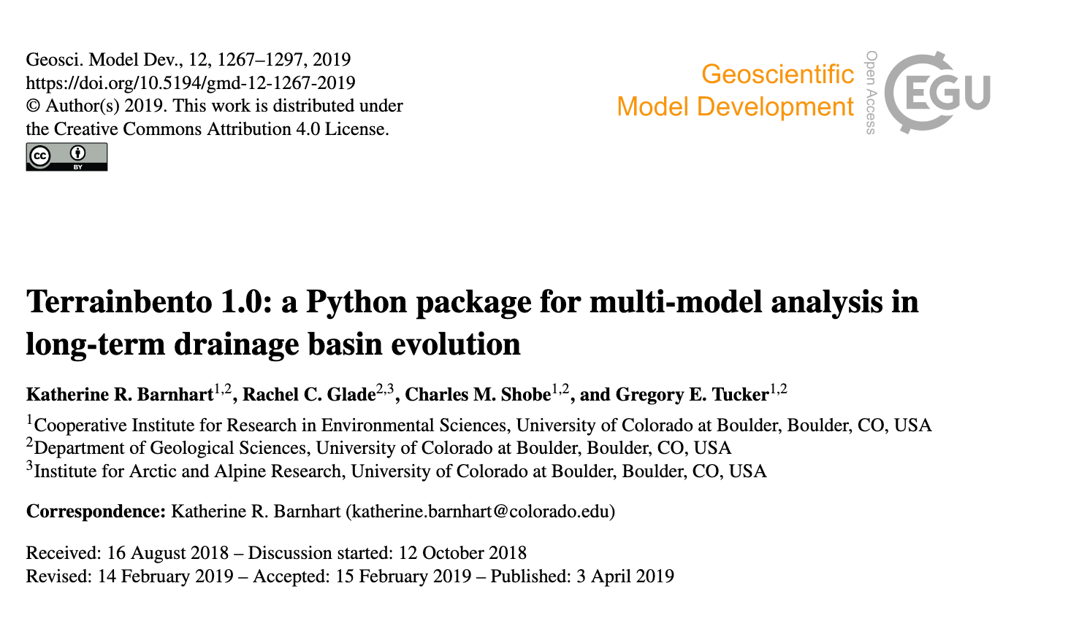

Slide 6
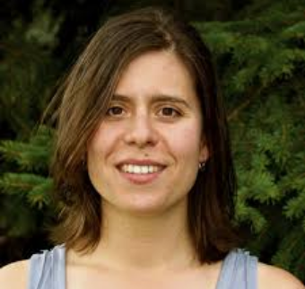



Notes:
I am the messenger, don’t want to steal their thunder

Slide 7
What is Terrainbento
a Python package that enables
multi-model comparison
sensitivity analysis
calibration of Earth surface process models

Slide 8
What is Terrainbento
a set of 28 model programs that implement alternative transport laws related to four process elements:
hillslope processes
surface-water hydrology
erosion by flowing water
material properties
The 28 model programs are a systematic subset of the 2048 possible numerical models associated with 11 binary choices.
Each binary choice is related to one of these four elements – for example, the use of linear or nonlinear hillslope diffusion.
Notes:
Question why 28 models?

Slide 9
What is Terrainbento
base classes that treat the elements common to all numerical models (such as input/output and boundary conditions) make it possible to create a new numerical model without reinventing these common methods
Terrainbento is built on top of the Landlab framework such that new Landlab components directly support the creation of new terrainbento model programs.
Notes:
Terrainbento is an extensible framework: base classes that treat the elements common to all numerical models (such as input/output and boundary conditions) make it possible to create a new numerical model without reinventing these common methods

Slide 10
What is Terrainbento
100 % unit test coverage
numerical comparison with analytical solutions for process models
continuous integration testing
We support future users and developers with introductory Jupyter notebooks and a template for creating new terrainbento model programs.

Slide 11
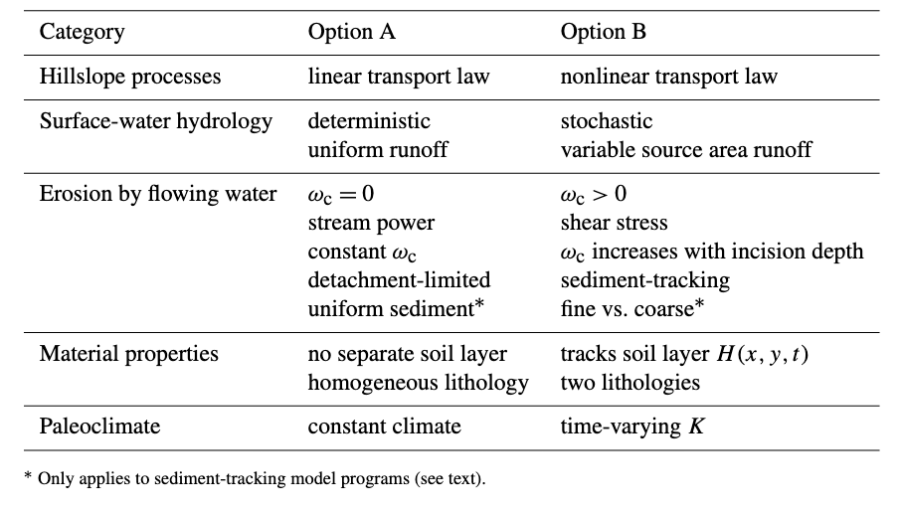
Level of sophistication
more realism BUT more parameters
Notes:
The binary options thatform the basis for the terrainbento 1.0 constituent model pro-grams are listed in Table 1. In Table 1, option B in each row usually represents a more sophisticated choice than option A:one that may bring more realism, but generally involves moreparameters

Slide 12
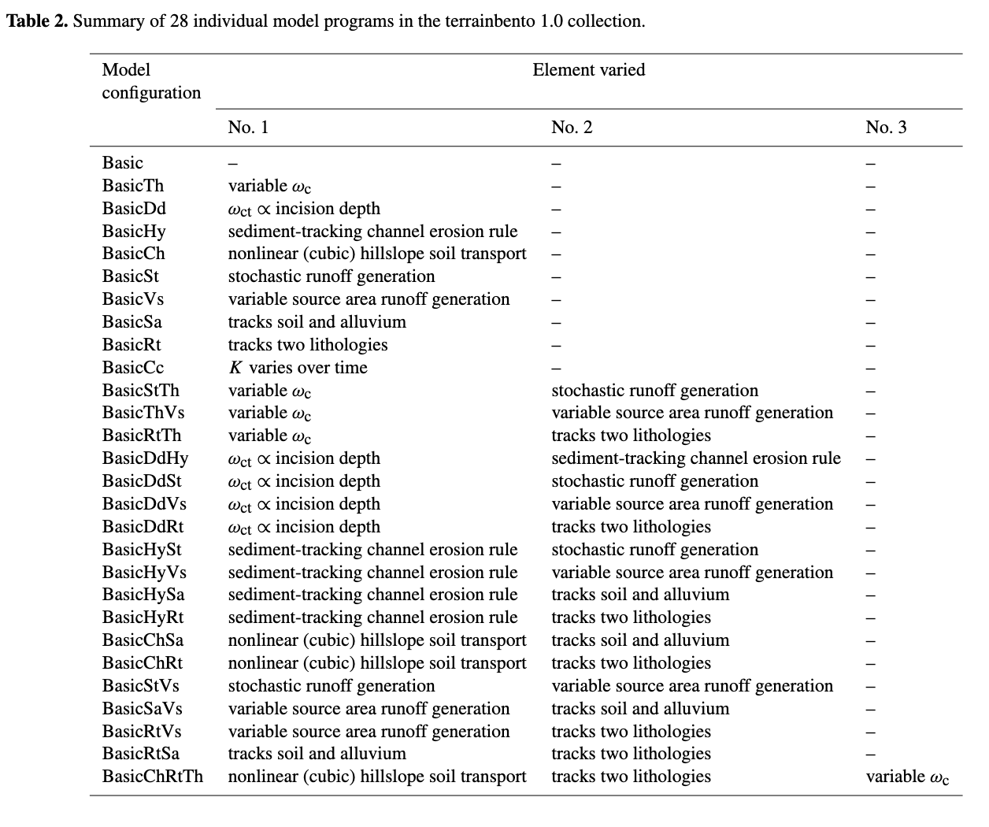

Slide 13
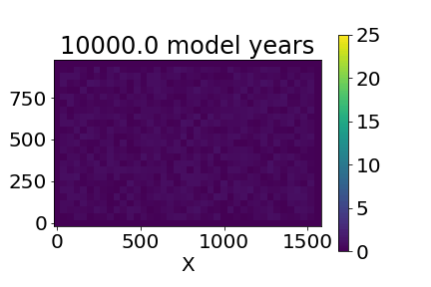
Goal of the day
Make a social-media friendly GIF of a LEM

Slide 14
Dictionaries
data type
Unlike sequences, which are indexed by a range of numbers, dictionaries are indexed by keys
keys are unique (within one dictionary)
key: value pairs
A pair of braces creates an empty dictionary: {}. Placing a comma-separated list of key:value pairs within the braces adds initial key:value pairs to the dictionary; this is also the way dictionaries are written on output.
Performing list(d) on a dictionary returns a list

